Slide 1
How to Improve Usability of WCET tools
Dr.-Ing. Christian Ferdinand
AbsInt Angewandte Informatik GmbH

Slide 2
The Timing Problem
Probability
Unsafe:
execution time
measurement
Safe worst-case
execution time
estimate
Best-case
execution time
Exact worst-case
execution time
Execution time

Slide 3
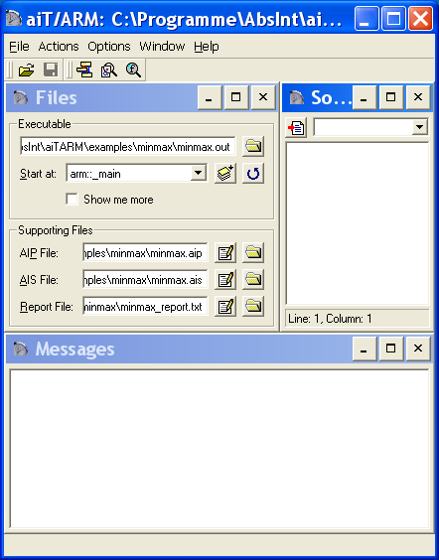
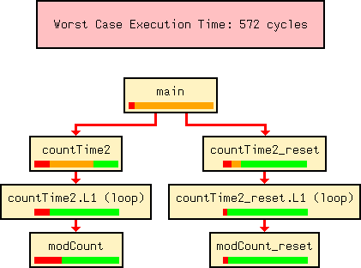

aiT WCET Analyzer
The solution to the timing problem
Global program analysis
  abstract interpretation for cache, pipeline, and value analysis
  integer linear programming for path analysis
Everything combined in a single intuitive GUI

Slide 4

aiT WCET Analyzer Structure
Executable program
CFG builder
AIS file
Loop trafo
CRL file
CRL file
Static
analyses
Path
analysis
Loop/value analyzer
ILP generator
LP solver
Cache/pipeline
analyzer
Evaluation
WCET,
visualization

Slide 5

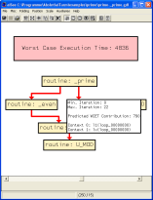
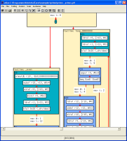
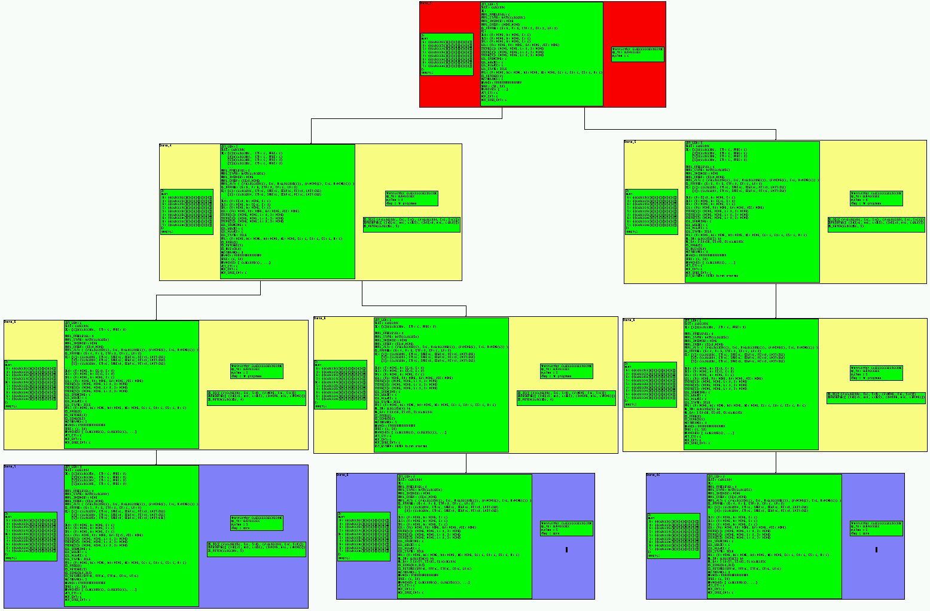
aiT WCET Analysis Input/Output
Application Code
Specifications (*.ais)
void Task (void)
{
variable++;
function();
next++:
if (next)
do this;
terminate()
}
clock 10200 kHz ;
loop "_codebook" + 1 loop exactly 16 end ;
recursion "_fac" max 6;
SNIPPET "printf" IS NOT ANALYZED AND TAKES MAX 333 CYCLES;
flow "U_MOD" + 0xAC bytes / "U_MOD" + 0xC4 bytes is max 4;
area from 0x20 to 0x497 is read-only;
Entry Point
Compiler Linker
aiT
Worst Case Execution Time
Visualization, Documentation
Executable (*.elf / *.out)
à =€@€ aŒ† | @€,@€;ÞKÿÿô;ÿ KÿÿØ‰€2}Œ`øÿÿ™€(8H#é³¡¶€(
Notes:
Der StackAnalyzer ist ein Werkzeug, um den Stackbedarf einer Anwendung zu ermitteln. Diese Funktionalität bietet er jedem Anwendungs-Sourcecode.
Für osCAN wird er dahingehend erweitert, daß die Anforderungen eines preemptiven Betriebssystems berücksichtigt werden. Die für die einzelnen Tasks zu konfigurierenden Stackgrößen werden übersichtlich angezeigt.
Das Tool besitzt die einzigartige Eigenschaft, den Stackbedarf aus einer statischen Analyse des Anwendungsprogramms zu errechnen. Hervorzuheben ist, daß auch rekursive Vorgänge berücksichtigt werden.
Bei der Analyse wird der Aufrufbaum ermittelt. Als interessanter Nebeneffekt bietet dieses Werkzeug somit eine genaue Analyse der Softwarestruktur.

Slide 6
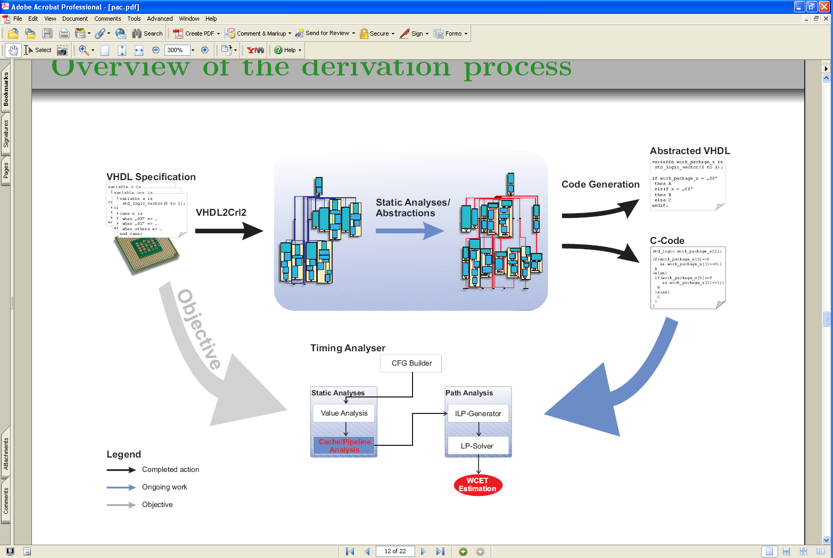
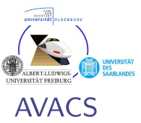
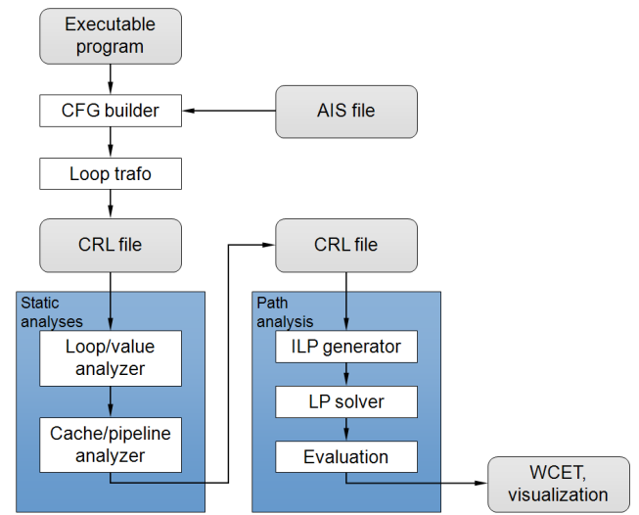



Correctness of Pipeline Models
Derivation of Pipeline Models from VHDL Specifications

Slide 7
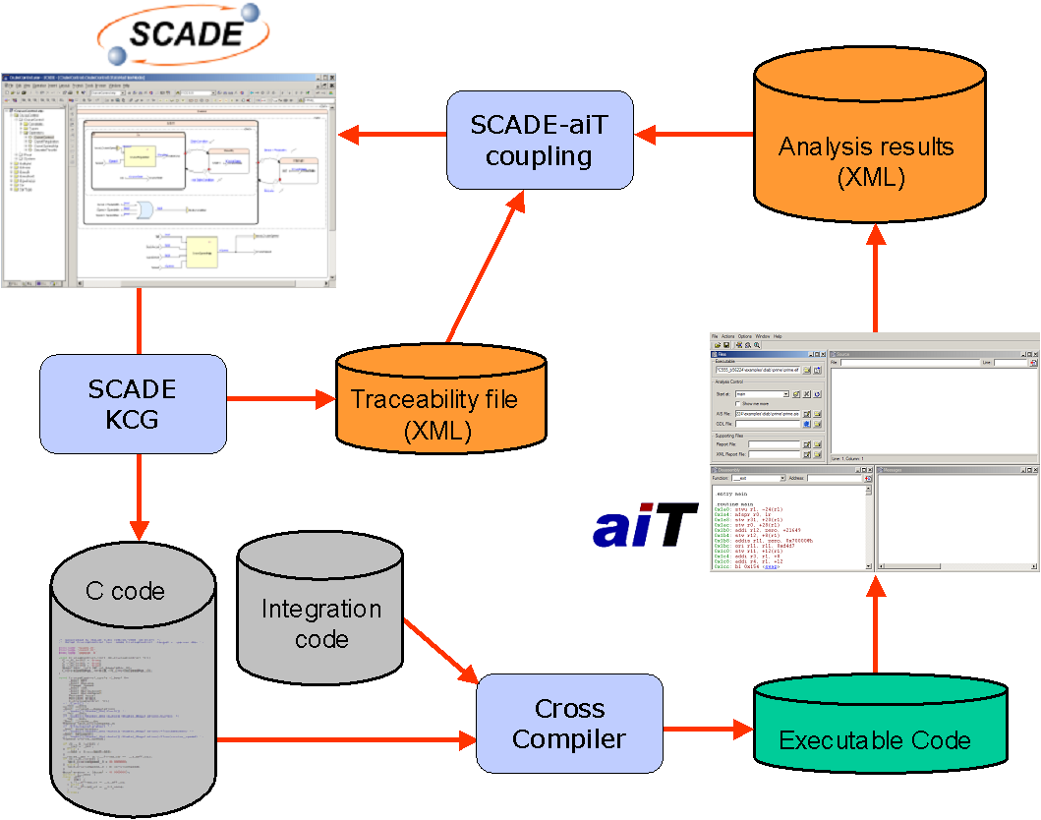
Integration into the Development Chain:
SCADE / aiT automated Flow

Slide 8
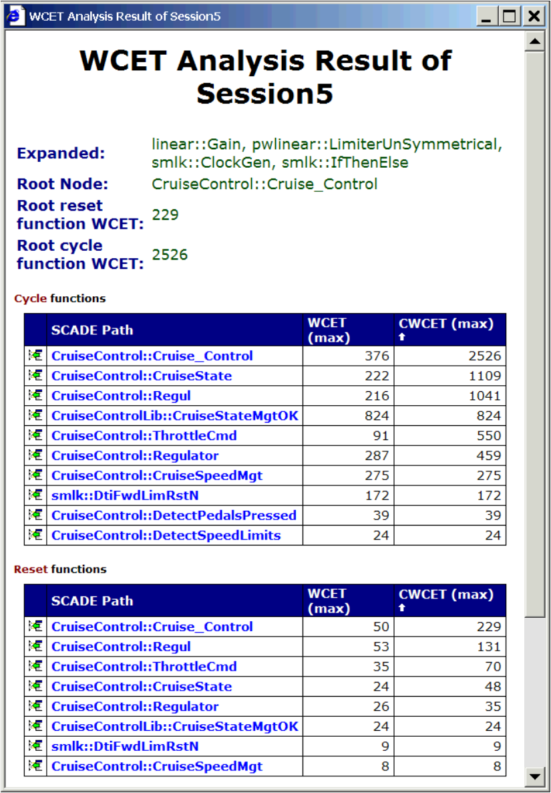
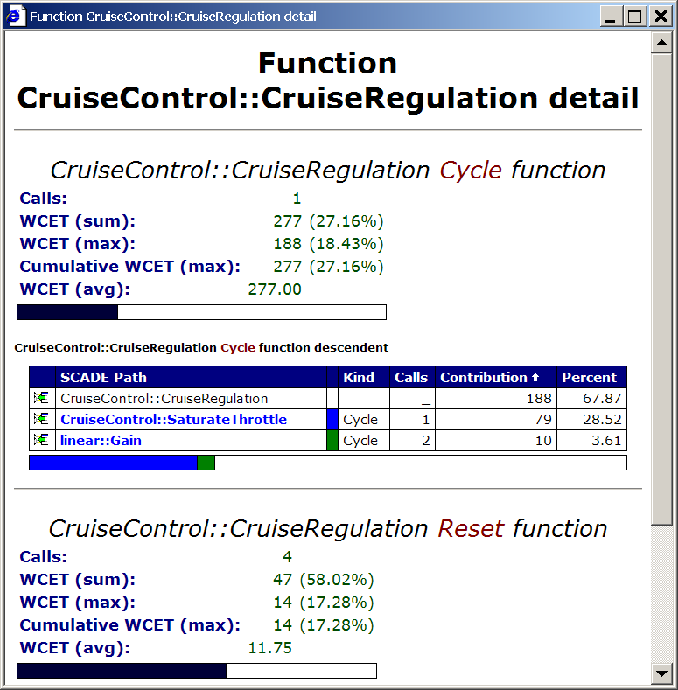
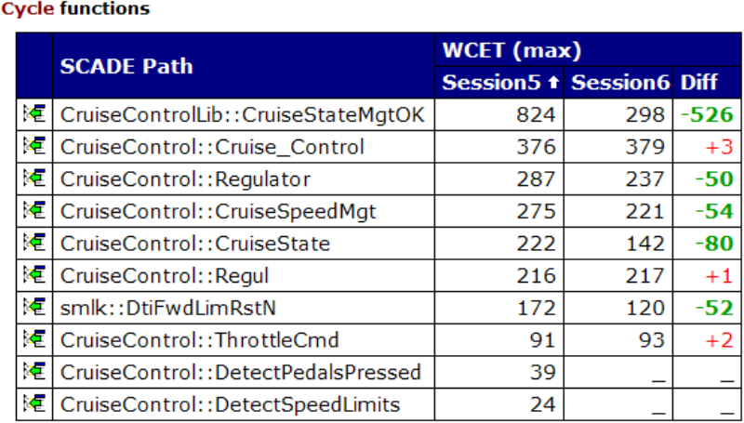
Integration into the Development Chain:
Analysis Reports
Customizable HTML reports
Global and detailed reports
Diff feature

Slide 9
Integration into the Development Chain:
Scheduling Analysis Tools
System level:
SymTA/S / RT-Druid
Code level:
aiT/StackAnalyzer
System model
(tasks, activation,scheduling)
Additional info
WCET/stack request
WCET/stack analysis
(single task)
Refinement
Scheduling analysis (WCRT)
system stack analysis
WCET/stack response

Slide 10
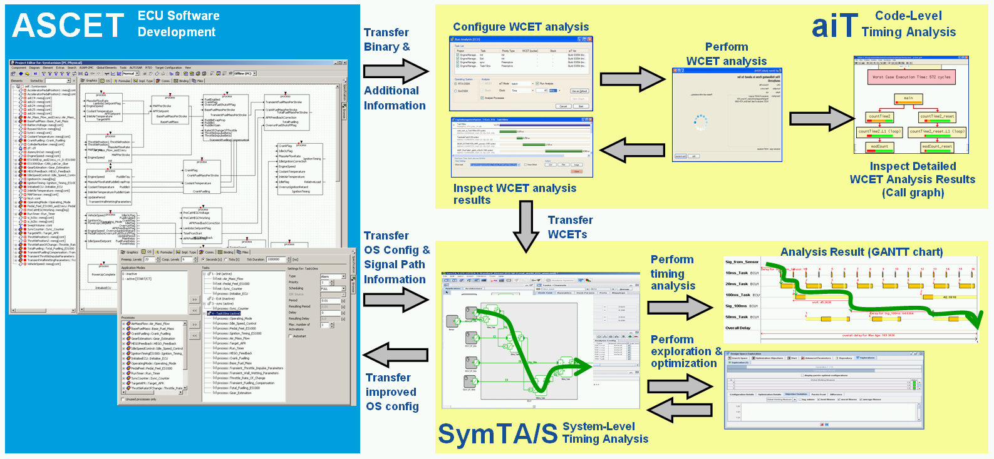
Integration into the Development Chain:
INTEREST Demonstrator: Engine Control System on TriCore 1796 (Ascet, SymTA/S, aiT)

Slide 11
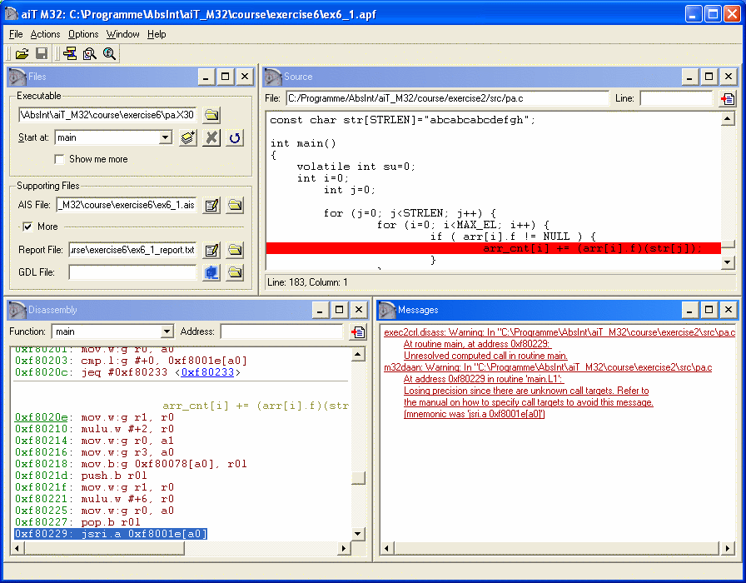

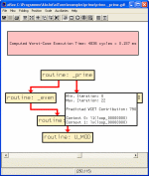
Exploration During Early Design Phases
TimingExplorer
T1
WCET
 | 388 | 500 | 253
 | 760 | 896 | 543
void Task (void)
{
variable++;
function();
while (next)
{
do this;
next--;
}
terminate();
}
T1
T2
Source files

Slide 12
Reduce the Amount of Annotations
Source-Level Analyses
Source-level analyses to automatically generate AIS-annotations
  SWEET from Mälardalen University
  SATIRE from TU Vienna
    Upper bounds of loop iterations
    Targets of indirect function calls
    Mutually exclusive program part
Optimizing compilers require inspection of the binary code

Slide 13

Reduce the Amount of Annotations
Source-Level Analysis:Automatic Mode Detection
A mode of an application is usually characterized by the values of a set of variables
  The mode variables determine the control flow of the application
  The mode variables usually do not change during the execution
Source-level analysis to automatically detect application mode variables and values
  Implemented with SATIRE

Slide 14
Summary
Safe deviation of pipeline models
Integrations with model-based development tools
Interface to scheduling analysis tools
Support to reduce the amount of annotations
New application areas
  Software integration
  Architecture exploration

Slide 15


Research Projects

Slide 16

Contact
www.absint.com
info@absint.com

